Slide 1
Reaching the Cloud
Amazon CDK hands on: Developing SaaS infrastructure as code
Ran Isenberg

Slide 2
Agenda
What’s it like to be a serverless developer?
AWS SaaS infrastructure framework options
CloudFormation
Framework options
CDK – from code to AWS resources
Use case example
Demo
Questions

Slide 3

About me
Ran Isenberg, 34, Software Architect at CyberArk.
I’ve been designing and developing microservices over Kubernetes during the last 2 years.
This year, I’ve joined an exciting new Cloud Native Serverless project in CyberArk which is deployed to AWS.
I’m very passionate about architecture design, Python coding, pc gaming and smart home automation.
ran.isenberg@cyberark.com

Slide 4
What’s it like to be a serverless developer?
Excellent ready to use services, “frustration free”
Don’t worry about HA, data replication, backups, service discovery etc.
Don’t care about barebones infrastructure or lambda containers
Everybody is a DevOps engineer
Infrastructure is now part of the project’s repo
New skills are required – cloud architecture
AWS is a huge LEGOLAND and it’s up to you to put the pieces together
Each cloud provider has its own quirks
For every problem, there are at least 3 solutions
What is the “right” solution?

Slide 5

What’s it like to be a serverless developer - contd
Serverless is changing rapidly and you need to keep up
New services & new capabilities are released all the time
You need to adapt and constantly learn
Cost matters and must be considered
Community knowledge sharing is lacking

Slide 6

AWS Cloudformation – infra as config
AWS service which “… allows you to model your entire infrastructure and application resources with either a text file or programming languages. ”
Defines stacks which hold AWS resources
Incremental updates
Auto rollback in case of failures
Delete a stack – all resources in the stack are deleted
{
“AWSTemplateFormatVersion”: “…”,
“Description: “…”,
“Parameters”: { … }, -> allows template reusability
“Resources”: { … }, -> actual resources to deploy
“Conditions”: { … }, -> for deploying
“Outputs”: { … }, -> for sharing params between services
}

Slide 7
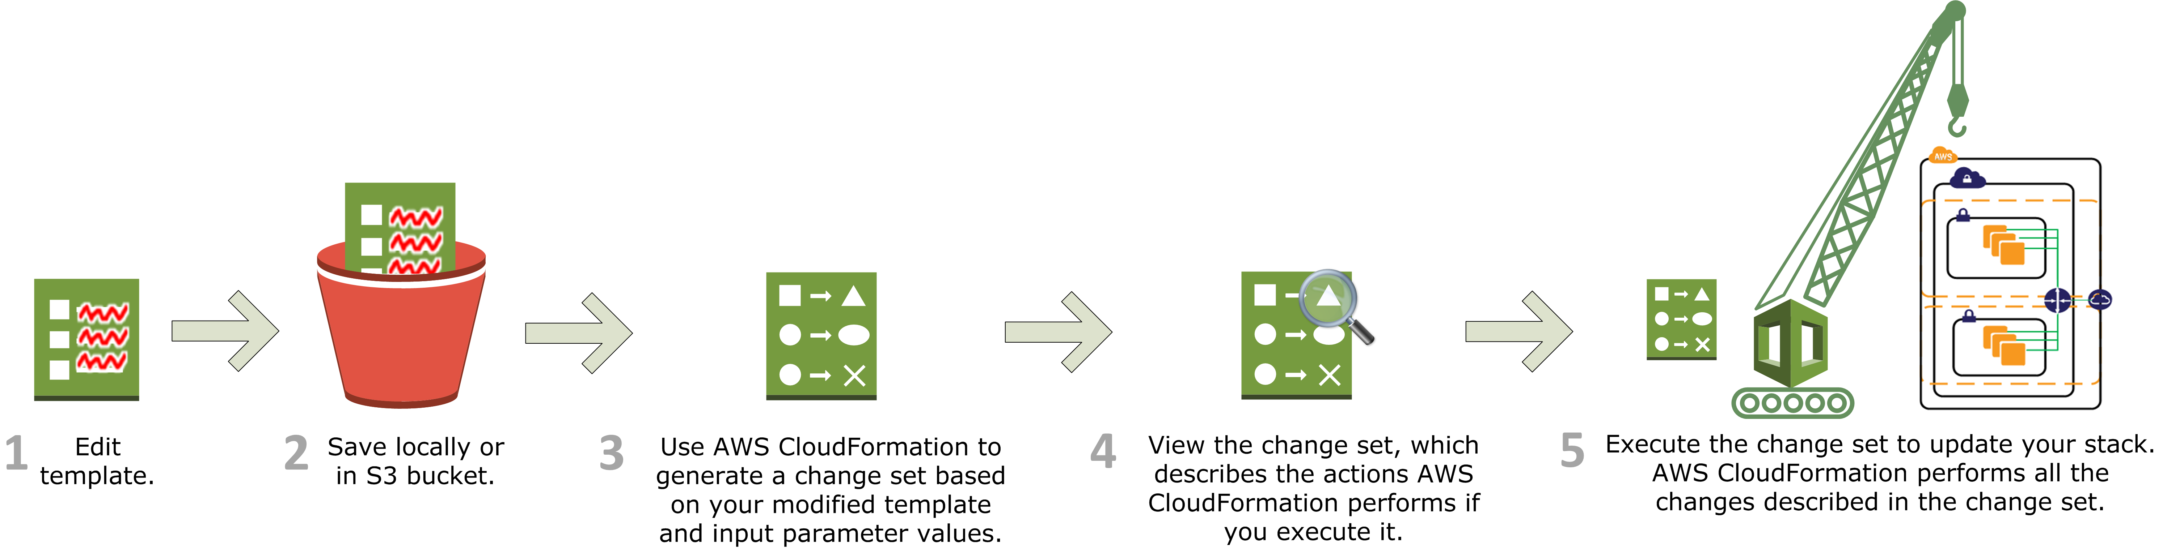
AWS Cloudformation – deployment stages

Slide 8
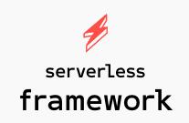

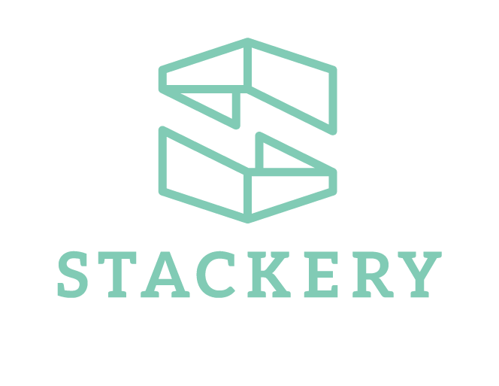


frameworks
CloudFormation is great but hard to write
Frameworks to the rescue!
But there are so many options...
Which to choose?

Slide 9
AWS Framework options*
They strive to make the developing easier, each in its own way.
Each framework has its own quirks and set features
Output in most cases a CloudFormation template.
Main players
Serverless - write YAML configuration, supports multi clouds
AWS SAM – SAM templates over CF, CLI - local lambda debugging, build & deploy
Terraform – HCL proprietary language, supports multiple clouds, doesn’t use CloudFormation
Stackery - build your IAC using a visual UI, support for deployment, branch management and more.
AWS CDK
* partial list

Slide 10
CDK – from code to AWS resources
Developer centric toolkit
Object oriented classes are translated into a cloud formation template
Import CDK code library, write code which is translated to CF.
Allows to build & deploy
Objects are validated, “compiled” prior to deployment
CDK is available in the following languages:
JavaScript, TypeScript (Node.js ≥ 10.13.0)
Python (Python ≥ 3.6)
Java (Java ≥ 8 and Maven ≥ 3.5.4)
.NET (.NET Core ≥ 3.1)
CDK for Terraform – write Terraform stacks with Python/Typescript code (only for AWS provider)

Slide 11
What did we choose?
We chose AWS CDK.
As engineers we prefer to write CODE.
It’s familiar.
We don’t want to write YAMLs or JSONs or other configurations.
We don’t want to learn a proprietary language or tool.
The infrastructure becomes just another Python library we use.
Learning curve is shorter

Slide 12
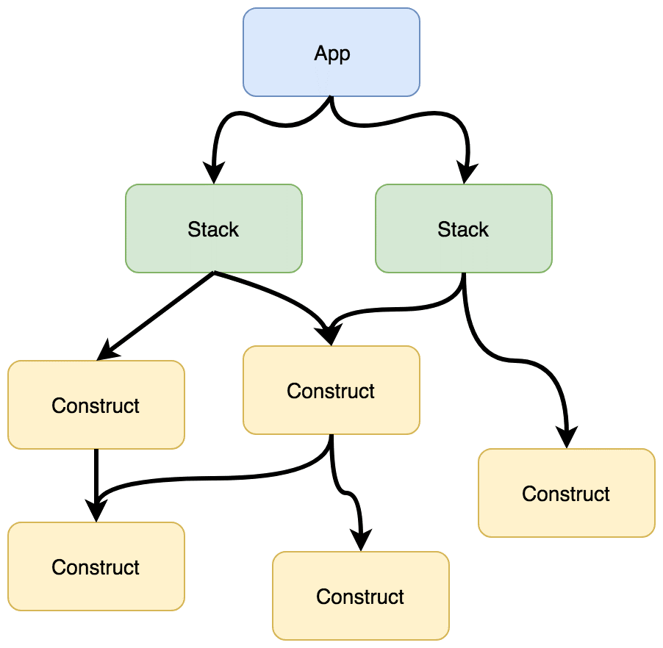
CDK – Terminology
Cfn resource – low level AWS resource
Construct
Collection of Cfn resources, higher lever of abstraction.
Reusable.
S3 bucket with encryption, DynamoDB with streams etc.
Can also contain other constructs.
Stack
A collection of constructs, resources deployed together.
Unit of deployment.
App – a microservice consisted of stacks.
CDK supports all Cfn template options.
You can define all the resources that cloud formation supports.
However, most services have high-level abstractions.
Cfn
Cfn
Cfn
Cfn
Cfn
Cfn
Cfn

Slide 13
CDK – Steps of deployment
bootstrap ➔ validate & synthesis ➔ publish ➔ deploy
Bootstrap: provision resources required to deploy CDK apps into all environments in advance (such as an S3 bucket, various IAM roles that trust the central deployment account). Created once per AWS account.
Validation: each construct calls its inner validation method. Discover errors in “compilation” instead of deployment time.
Synthesis: produces a cloud assembly output in ‘cdk.out’ folder.
It includes CloudFormation template for each stack and asset sources (lambda zip, docker files, etc) that must be packaged and published to the asset store in each environment that consumes them.
Publish: package and publish all assets to asset stores (S3 bucket, ECR repository) so they can be consumed.
Deploy: assume deployment role and deploy stacks are deployed AWS.

Slide 14
CDK – proS
Doesn’t require learning a new language
Doesn’t involve YAML/JSON know how
Easier to debug/read
Reusable constructs, can share between services & teams.
Compile time errors instead of during deployment runtime
Can always fallback to Cfn low level resources
AWS backed
Open source – can open issues and donate code
AWS Solutions Construct Patterns

Slide 15
CDK – cons
New tech - not enough code examples
Changes rapidly – sometimes with breaking changes.
Not all services/options in services are covered with high level abstraction – requires low level Cfn resources.
15

Slide 16
Use case – tenant management service
All SaaS applications have customers, hopefully ☺
Customers need to be on-boarded, provisioned and managed
We will build using CDK a service which offers a REST API to the SaaS manager to add, get and list customers.
We will deploy:
REST API lambdas using API gateway
DynamoDB table with streams
Lambda destination for streams’ changes
EventBridge bus
All IAM roles

Slide 17
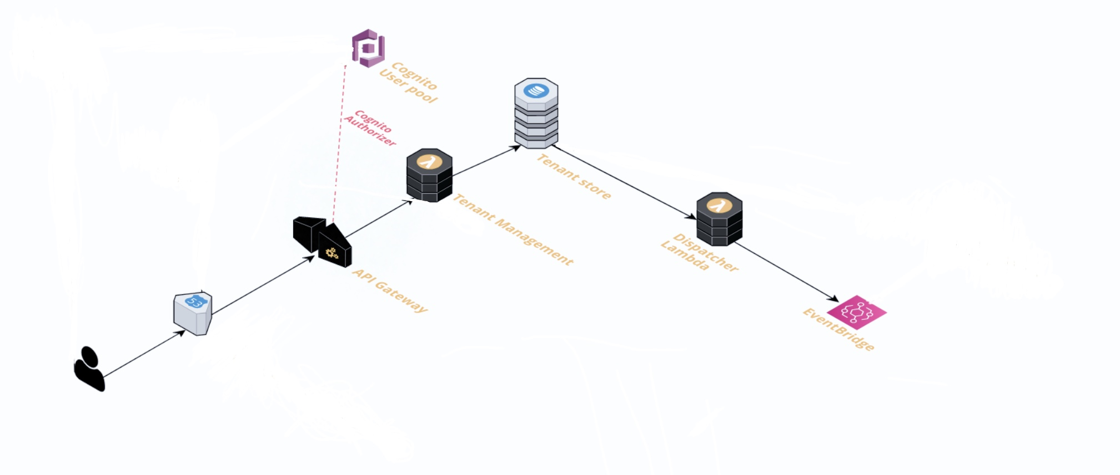
Use case – tenant management service
Cognito user pool & route53 are deployed in another stack

Slide 18
REST API
Create Tenant – HTTP POST to /tenants with json body
List all tenants – HTTP GET to /tenants
Get specific tenant – HTTP GET to /tenants/{tenat_id}
Tenant_id is a string UUID.

Slide 19


